Slide 1
E-commerce Customer Segmentation & Prediction

Slide 2

Agenda
Problem Statement & Objectives
Dataset Overview
Data Cleaning & Preprocessing
Exploratory Data Analysis (EDA)
Feature Engineering (RFM Analysis)
Customer Segmentation (K-Means)
Model Comparison
Predictive Modeling
Feature Importance
Business Insights & Recommendations
Conclusion

Slide 3

Project Overview & Objective
Project Overview:
This project focuses on analyzing customer purchasing behavior in an e-commerce platform to segment customers into meaningful groups and predict future customer segments using machine learning techniques.
Objectives:
Understand customer purchasing patterns.
Segment customers based on Recency, Frequency, and Monetary value.
Build a predictive model for customer classification.
Generate actionable business insights for marketing strategies.

Slide 4

Dataset Overview:
Key Features :
• Invoice Number • Stock Code & Product Description • Quantity Purchased • Unit Price • Invoice Date • Customer ID • Country
Dataset Description:
The dataset consists of transactional records from an e-commerce platform capturing customer purchases across various products and time periods.
Dataset Size
• Over 400,000 transaction records • Thousands of unique customers
Purpose
To analyze customer behavior and build data-driven segmentation and prediction models.

Slide 5
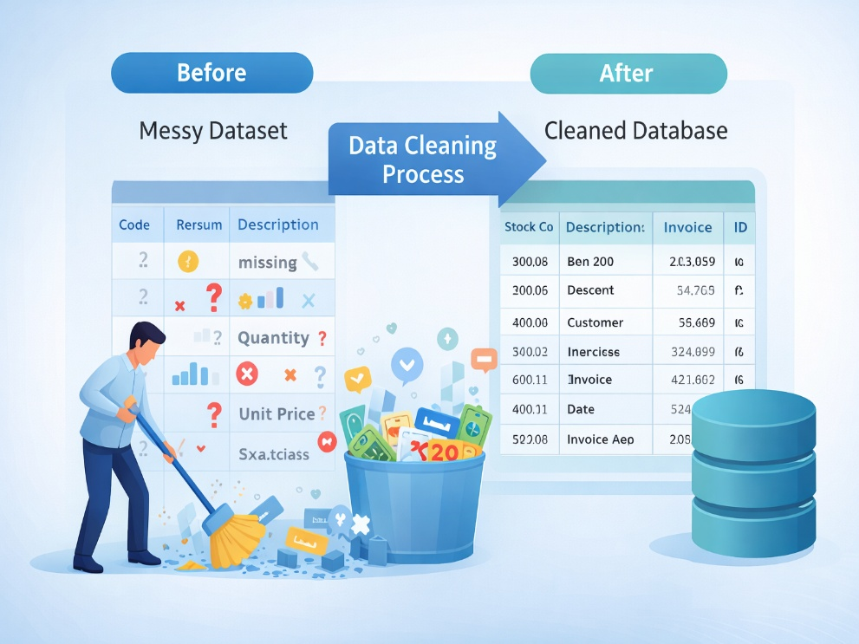
Data Cleaning & Preprocessing
Key Steps Performed :
Removed records with missing Customer ID
Eliminated negative or zero quantity values
Removed invalid unit price entries
Converted Invoice Date to datetime format
Removed duplicate transactions
Outcome:
Clean and reliable dataset
Improved data quality for accurate analysis and modeling

Slide 6


Exploratory Data Analysis:
Purpose:
To understand customer purchasing behavior and identify key patterns in the dataset.
Key Analyses Performed:
Distribution of purchase quantity
Product price behavior
Transaction value trends
Country-wise revenue contribution
Customer purchase frequency
Monthly revenue trend

Slide 7
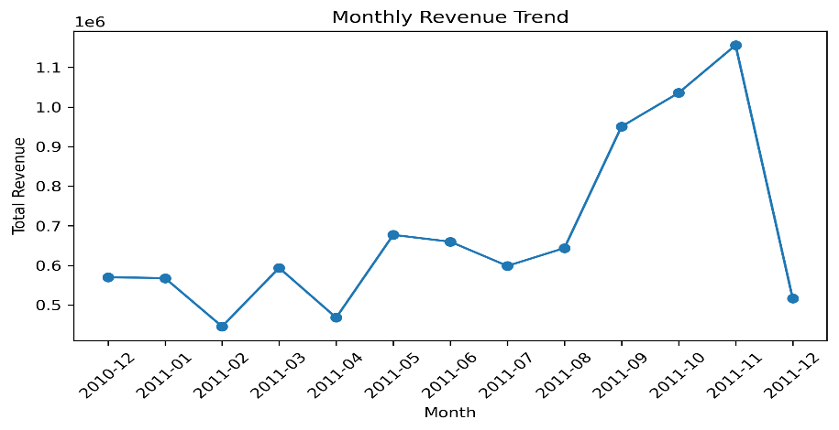
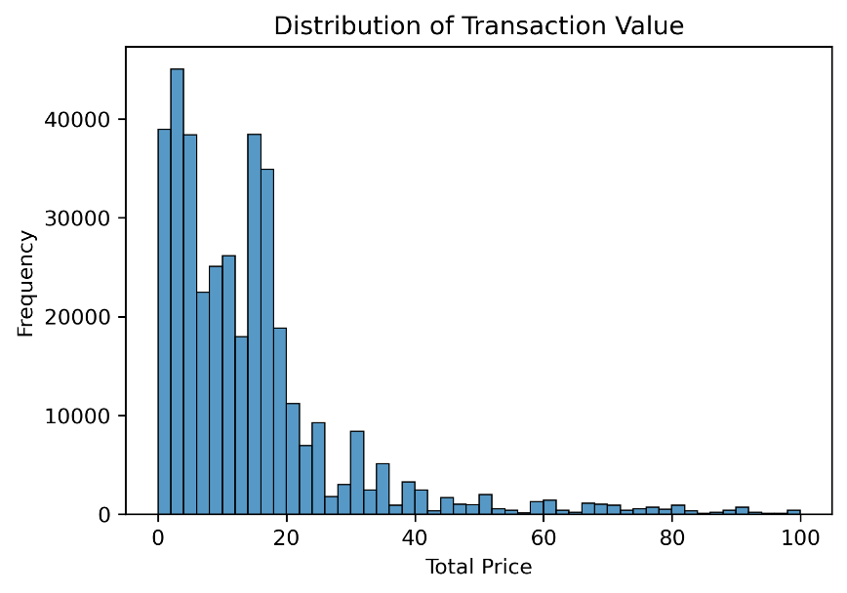
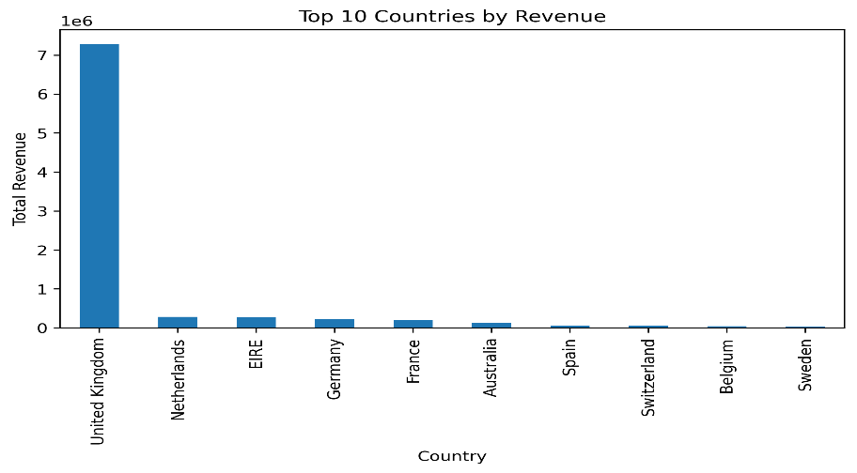
Key Observations:
Key Observations:
• Majority of transactions are low value, indicating frequent small purchases • Revenue is highly concentrated among a small group of customers • United Kingdom contributes the largest share of total revenue • Clear seasonal trend observed in monthly sales • Presence of high-value outliers suggests premium customer segment

Slide 8

Feature Engineering – RFM Analysis
RFM Metrics Used:
Recency – Days since last purchase
Frequency – Number of purchases
Monetary – Total spending
Thank You!
Key Insight:
RFM converts transaction data into customer behavior profiles
Helps identify high-value, loyal, and inactive customers
Forms the foundation for effective customer segmentation
CustomerID | Recency | Frequency | Monetary
12346.0 | 325 | 1 | 77183.60

Slide 9
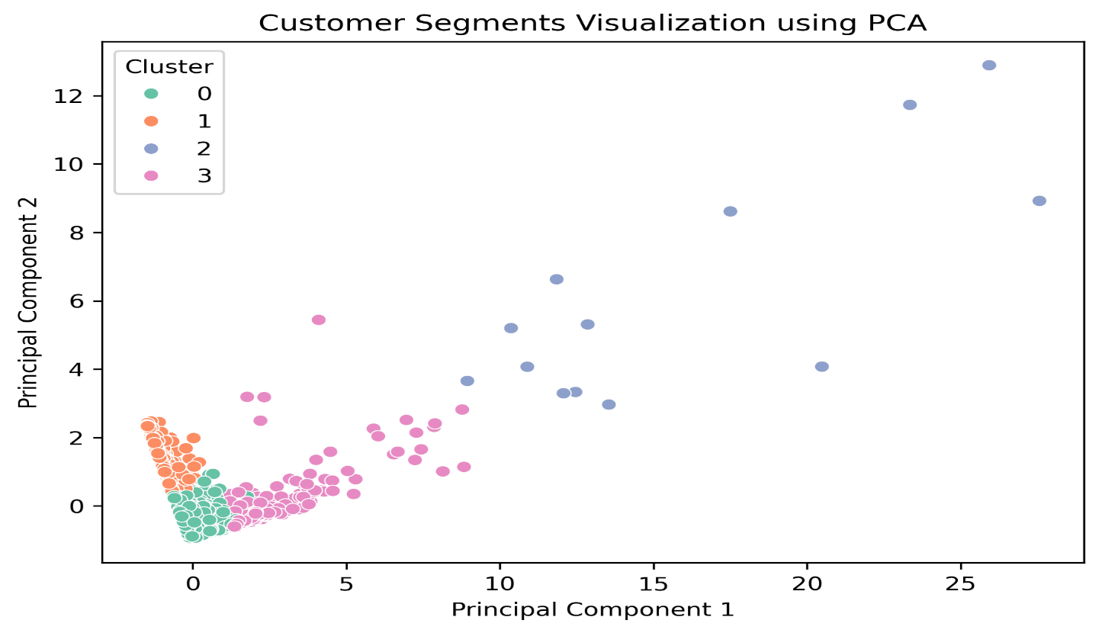
Customer Segmentation – K-Means Clustering
Segmentation Approach:
Applied K-Means clustering on RFM features
Optimal number of clusters selected using Elbow Method
Customers grouped based on purchasing behavior
Key Result:
Customers are clearly grouped into distinct behavioral segments
One segment represents high-value customers with strong purchasing activity
Majority of customers fall into low-to-moderate engagement groups
Clear separation confirms effective clustering and meaningful segmentation

Slide 10
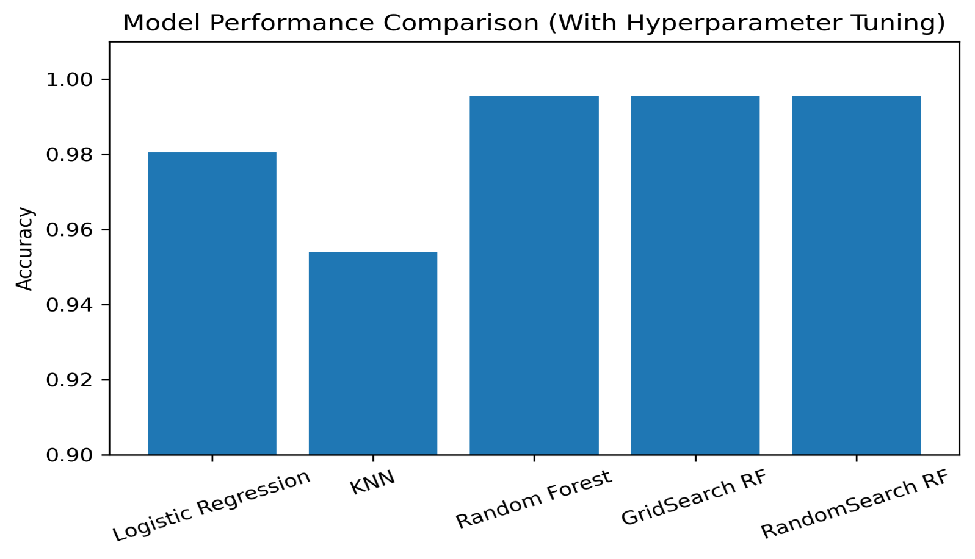
Model Comparison
Random Forest achieved highest accuracy
Hyperparameter tuning further improved performance
Final model selected based on best generalization

Slide 11

Predictive Modeling
Objective: Predict customer segments using machine learning
Input Features: Recency, Frequency, Monetary
Model Used: Classification model on clustered data
Result: High accuracy in identifying major customer groups

Slide 12
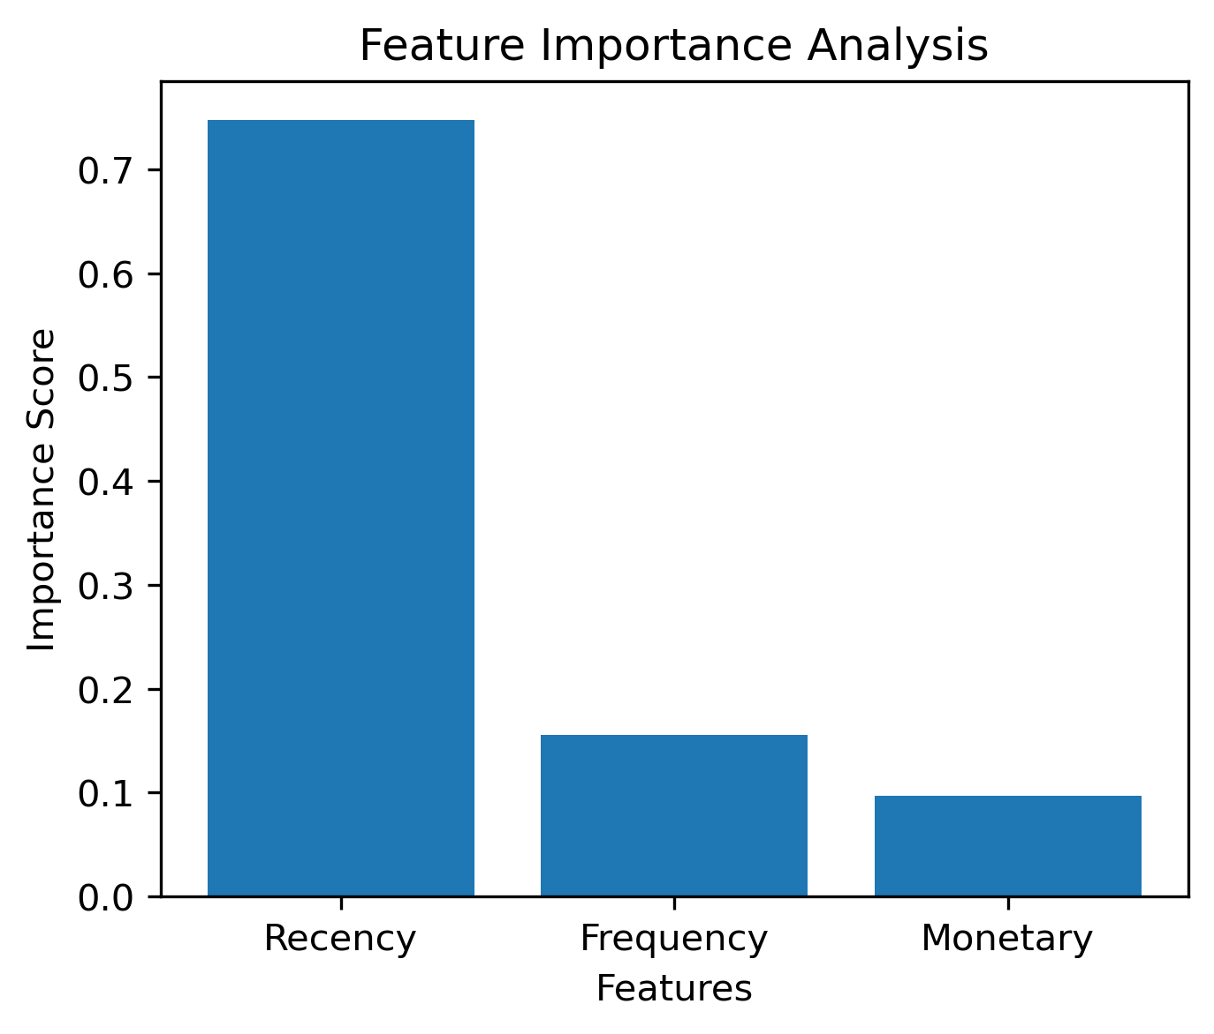
Feature Importance
Recency is the most influential factor in customer segmentation
Frequency indicates customer engagement level
Monetary value reflects revenue contribution
Recent activity drives customer value more than past spending

Slide 13

Business Insights & Strategic Recommendations
Key Insights:
A small customer segment generates most of the revenue
Recent purchase activity strongly predicts customer value
Most customers show low spend and low engagement
Strategic Actions:
Prioritize retention of high-value active customers
Re-engage inactive customers with targeted offers
Personalize marketing using customer segments

Slide 14

Conclusion
Successfully segmented customers using RFM analysis and K-Means clustering
Identified high-value and low-engagement customer groups effectively
Built a predictive model with excellent classification performance
Discovered Recency as the most influential factor driving customer value
Generated actionable insights to improve retention and revenue growth

Slide 15
Thank You!

